Slide 1
AirBnB Rental Properties
AirBnB / 2025
By Jacob Vogelpohl

Slide 2
Data Questions
How much do Airbnb and Zillow Rent in Nashville differ
Do the cheaper areas have more incidents with crime?
You need a certain income to rent on Zillow, is that the same for Airbnb?
Do Hosts and their listings have a play in the cost of their rentals?
What areas are under or over the average of all Nashville rent?
What Crime is most popular in the areas under the average? Over?
What is the most expensive listing on Airbnb? The Cheapest?

Slide 3
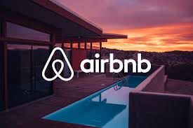
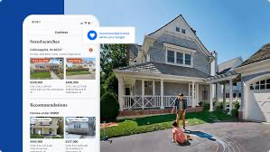
Airbnb VS Zillow

Slide 4
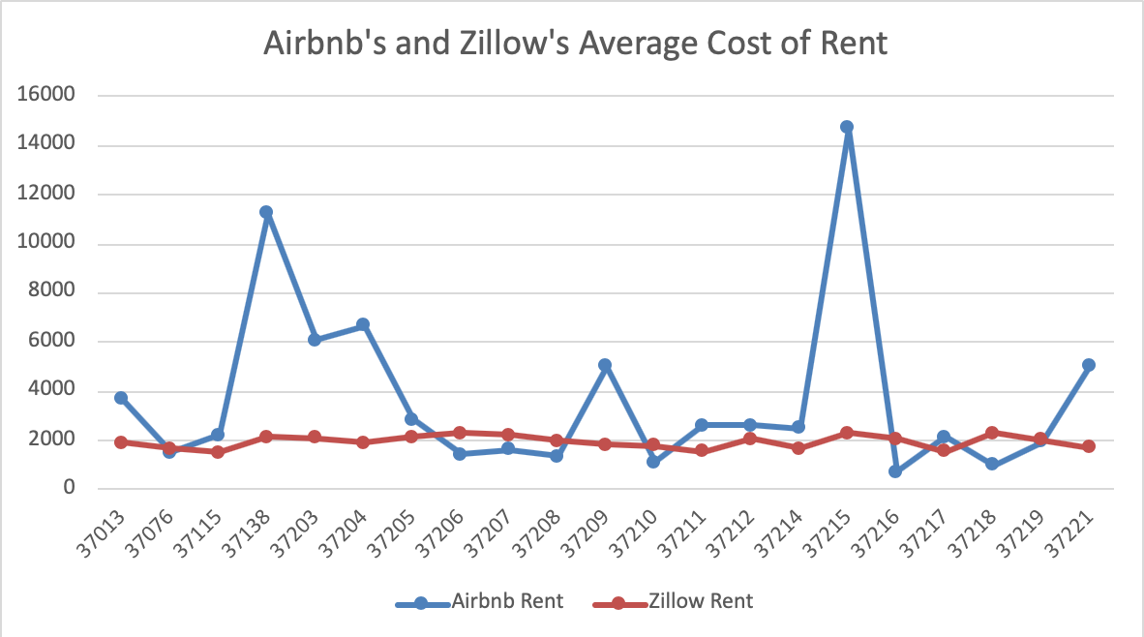
Q1
Looking into the average pricing of the rentals in each zip code there was no correlation to the pricing of Airbnb and zillow rentals.
The highest Average rent for Zillow is in 37206, while Airbnb’s is 37215, and the price difference is immense.
Zillow rents were not too far off from each other, while Airbnb’s were varied a lot
The Average Rental Pricing

Slide 5

Q2
To my surprise the amount of incidents did not seem to mean that area was going to have lower cost, the highest count is one of the more expensive areas.
So I wanted to do a little more of a diligent search on the dataset.
Top Five Zip codes with the most Police Incidents

Slide 6
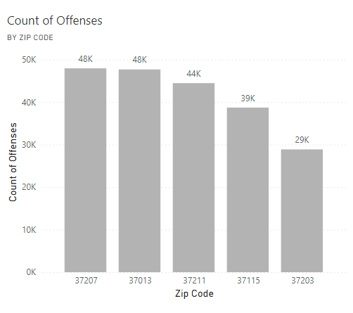
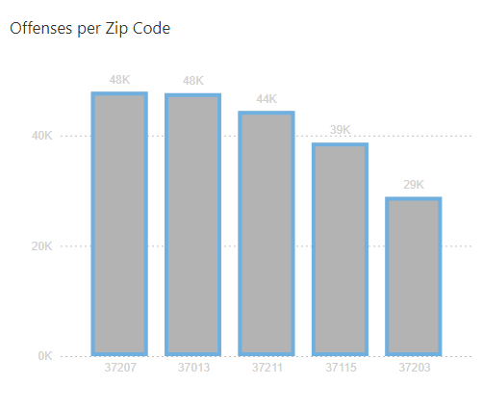
Q2
To my surprise the amount of incidents did not seem to mean that area was going to have lower cost, the highest count is one of the more expensive areas.
So I wanted to do a little more of a diligent search on the dataset.
Top Five Zip codes with the most Police Incidents

Slide 7
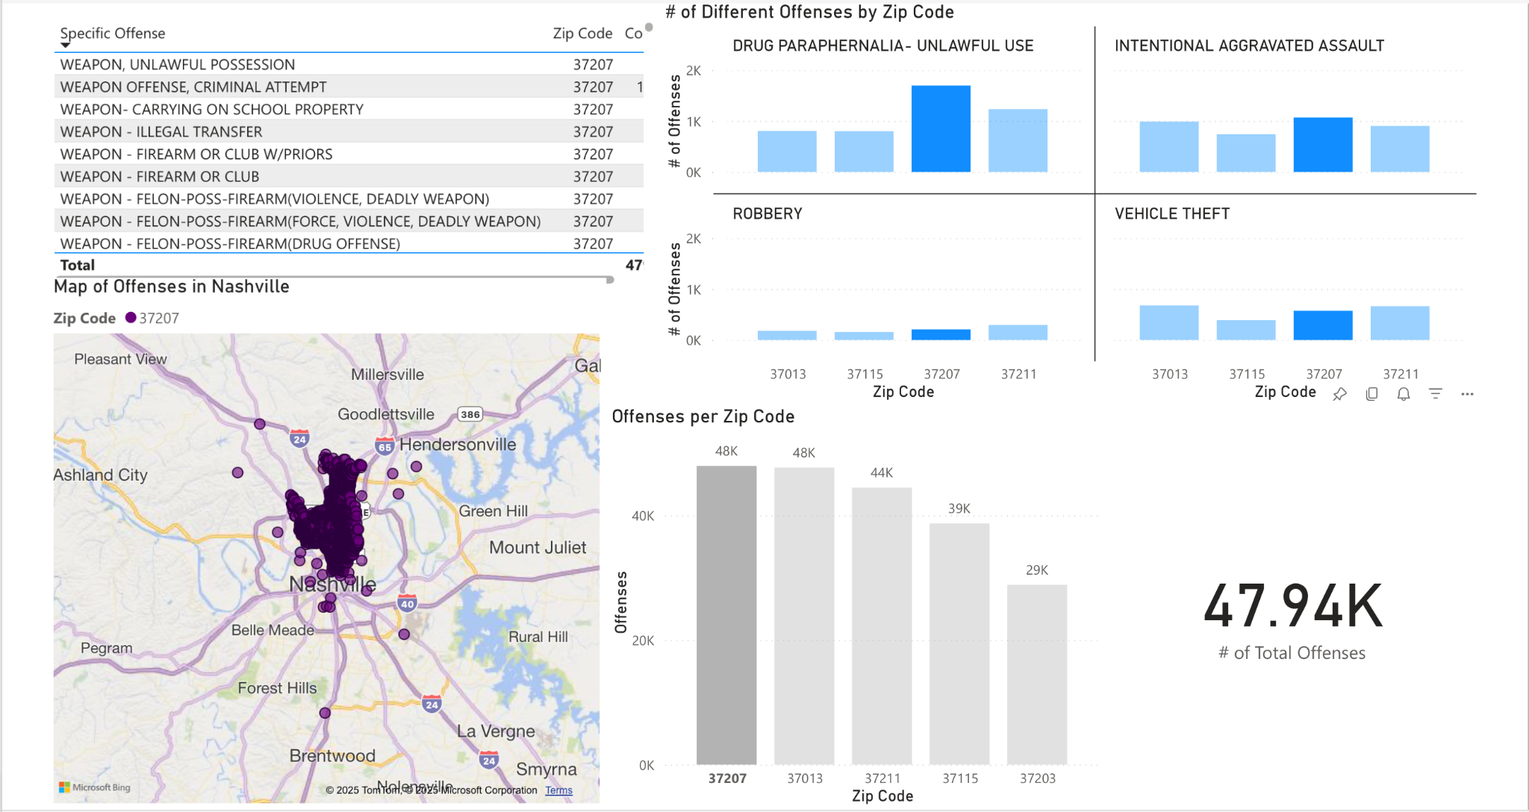
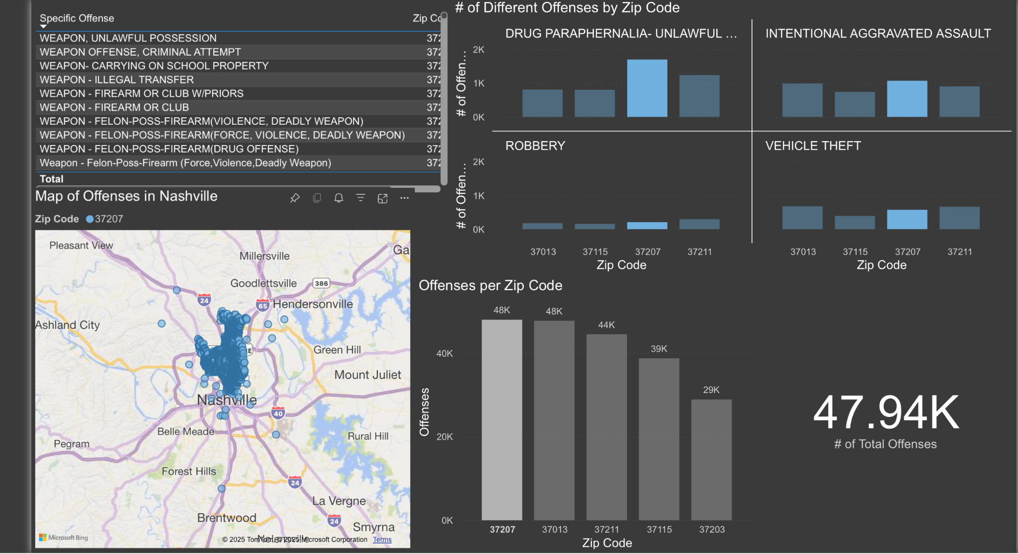
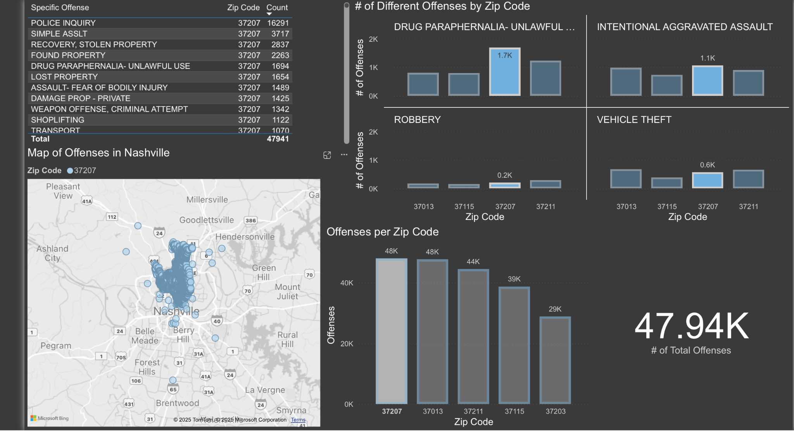

Slide 8

Q3
Listings on Zillow list an income of a certain percentage above the rent, the majority it is 1.5x the rent to have less of a risk with a tenant.
I wanted to see if Airbnb had this option as well, but there is no where on listings that mention it, this may be one of the reasons Airbnb can price however much the host want.
Income to Rent

Slide 9
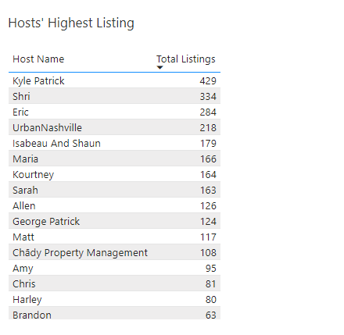
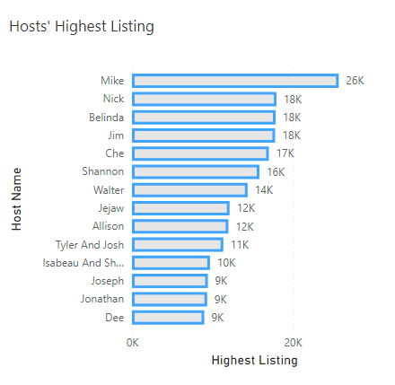
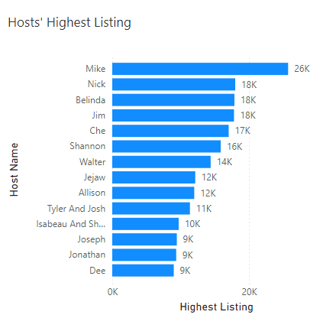
Q4
I wanted to see if there was any correlation to rent prices with airbnb to the amount of listings a Host had in total. So I compared the hosts with the highest listings with the Hosts with the highest total listings.
There was only one match out of the top 15.
Those with more experience and more listings understand keep them as affordable as possible.
Host on Airbnb

Slide 10
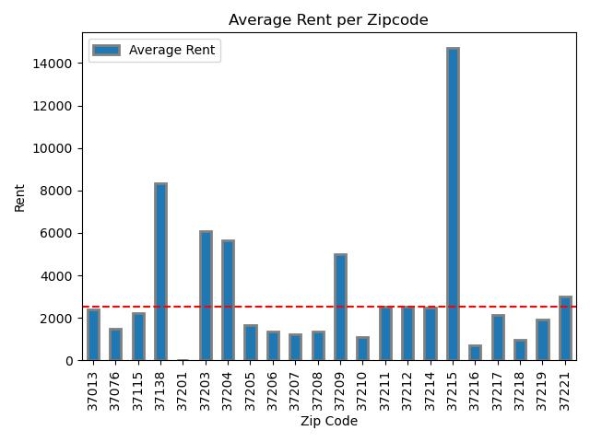
Q5
The average rent with airbnbs in Nashville is $2538.38 which I find surprising after finding so many expensive listings.
So the majority of listings on Airbnb for Nashville are under the average.
There is one obvious outlier of the bunch and the average rent for Zip Code 37215 is $14700, and it is mainly to do one listing that is priced over $30,000 a month
Average Cost of rent in Nashville

Slide 11
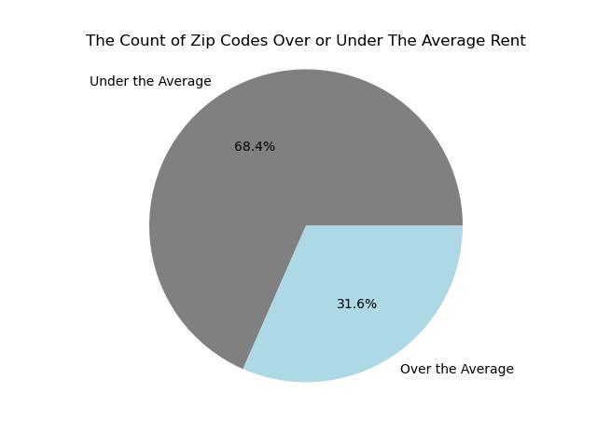
Q5
What percentage of Nashville is under and over the average rent?

Slide 12

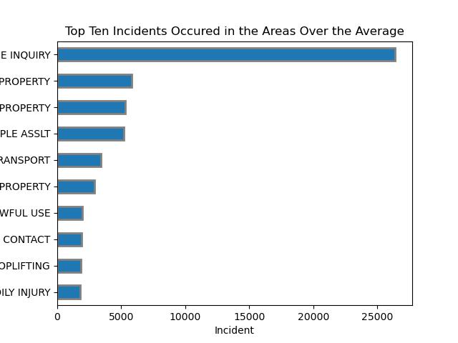
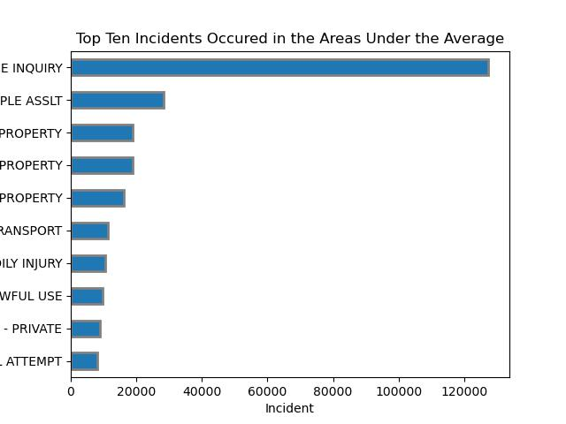
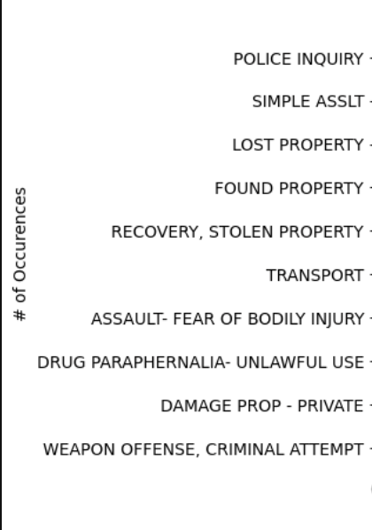
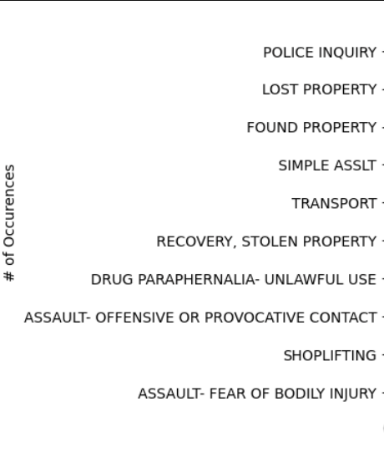
Q6
When you look into the pricing of those areas, one factor can be the amount of crime in that area.
Now there are more areas under the average so there will be more incidents, but these graphs still do tell us some of the differences.
There is a higher possibility of crimes with weapons under the average, but a higher chance of shoplifting which is the main difference between the two
Incidents Under the Average Vs Over

Slide 13
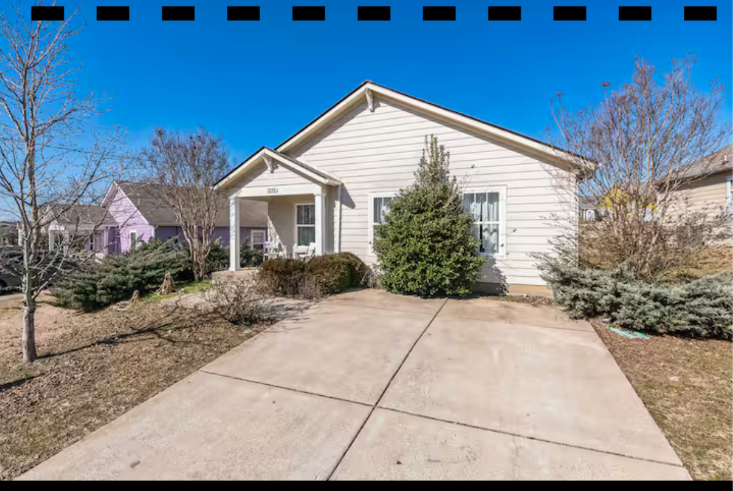
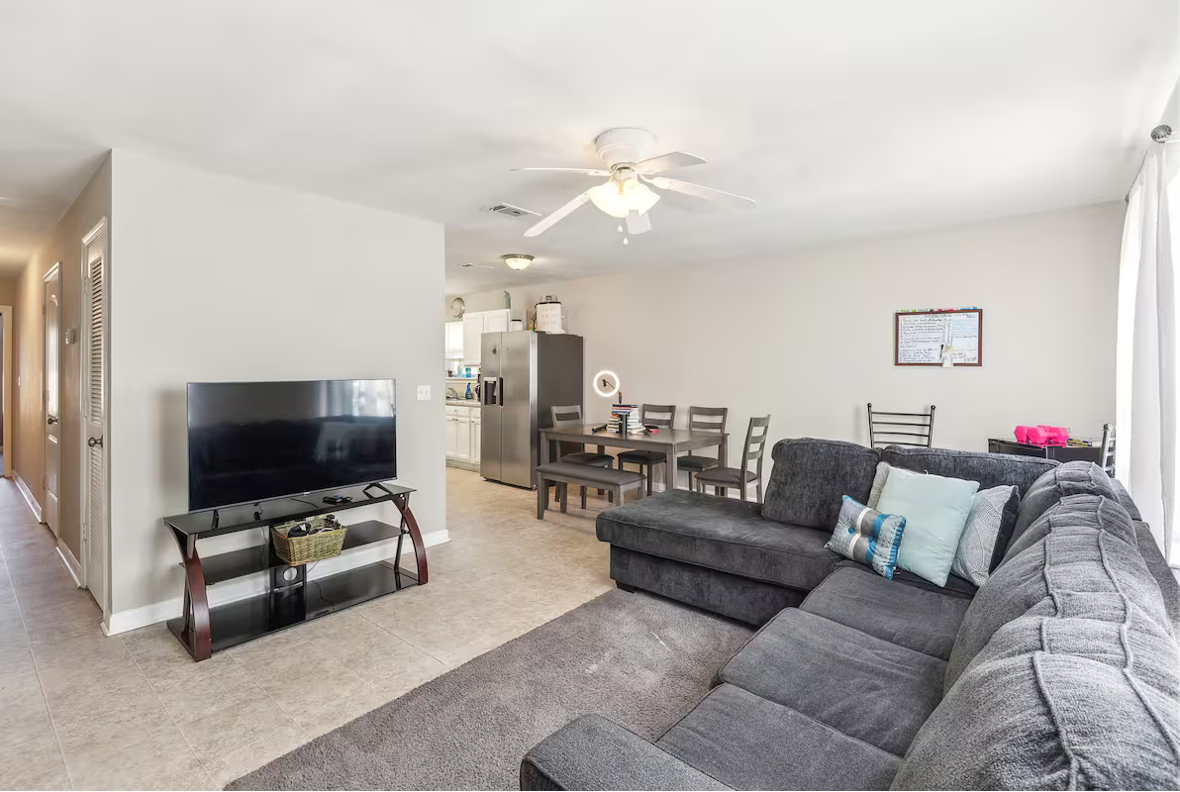
Q7
Here is the cheapest option for at least 60 days to live in Nashville.
It is a Private room in 37207, which is main downtown area of Nashville.
The monthly rent is only $570 a month.
Unfortunately there is no image of the room you would rent
Lowest Rental Property

Slide 14
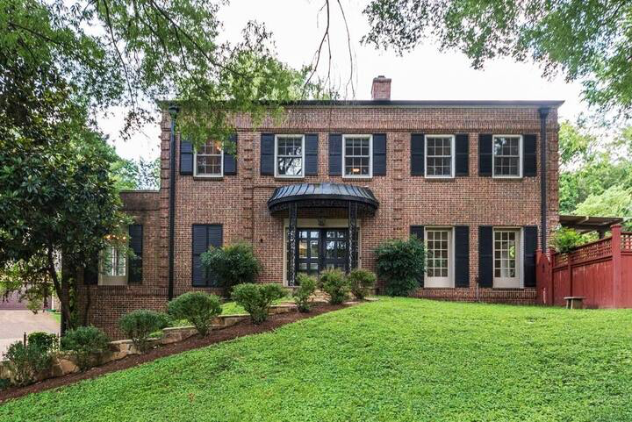
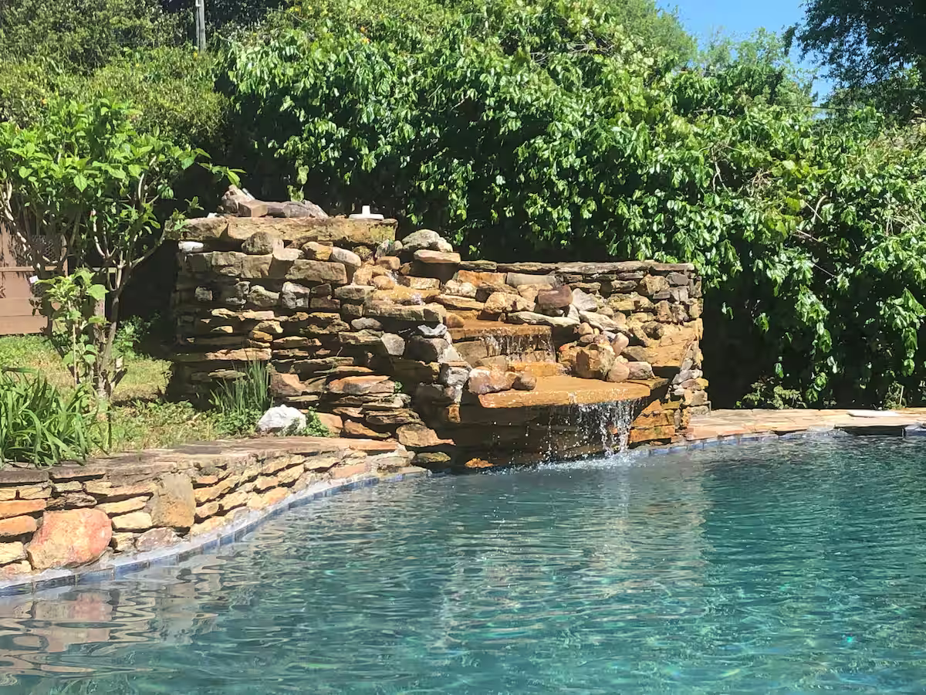
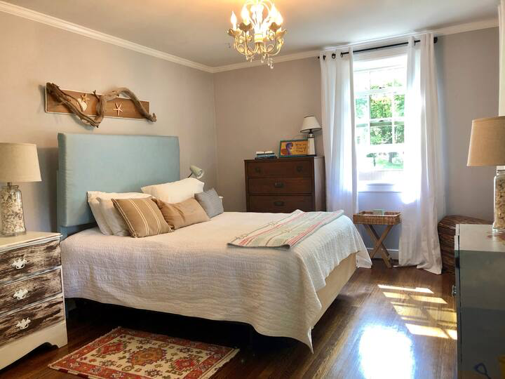
Q7
Here is the Highest option for at least 60 days to live in Nashville.
It is a Executive Home w/ Pool in 37215, which is the Green Hills area.
The monthly rent is only $30000 a month, this was the reason this areas average was so high.
Here are images of the house you would be renting.
Highest Rental Property

Slide 15
What to take from this
When looking into the Averages it may seem too unpredictable to know if it were to be better to rent on Zillow or Airbnb.
Airbnbs do not have to follow the same rules as Zillow landlords do, as certain income above the rent, or pricing of their rent to have cap or bottom.
You can see many more reviews about hosts on Airbnb than on zillow, because you can see all reviews of those who rented from the host either for two nights or a year, zillow you will only find a certain lease term
You have a wider variety of places to stay either it be private rooms, guest house, or entire houses, zillow you only have the option for the entirety of the place you are renting.
The availability, and easiness of booking on airbnb is so easy, just by pressing book the time you want to be there for and you got it, zillow you have to go through much more of a hassle
Airbnb may seem a little unconventional to rent for, and may have never been a thought but there are some amazing opportunities to be made and chances to find a great spot to live!
Whether it is the Zillow Pricing or Airbnb pricing, but the more expensive areas do not always mean less incidents with the police, but it does have a lot of calls to the police.
Renting and housing right now is atrocious so I hope this helped be informative of places to look into for renting, and that you use this data to find a spot right for you.

Slide 16
THANK YOU!

